Slide 1
High-throughput asset pricing
Presented by Hoang Ngan

Slide 2
Agenda
Overview
Introduction
Data & Strategy Construction
Methodology
Main Results
Experiments

Slide 3
OVERVIEW
Objective
Develop a scalable and unbiased framework for discovering return predictability.
Method
Generate 136,000 trading strategies
Apply Empirical Bayes shrinkage
Evaluate using out-of-sample tests
Main Finding
High-throughput methods can identify robust return predictability while reducing data-mining bias.

Slide 4
introduction
Traditional asset pricing studies suffer from data mining bias and publication bias
The paper proposes a different approach:
  mine data systematically and rigorously
  adjust statistical bias using Empirical Bayes (EB)
The resulting portfolio achieves strong out-of-sample returns comparable to top finance journals without look-ahead bias
Authors construct around 136,000 long-short strategies from:
  accounting ratios,
  past returns,
  ticker symbols

Slide 5
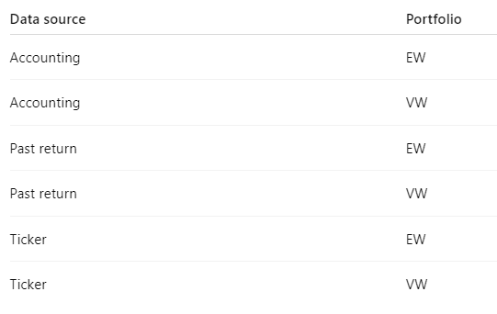
Data and Strategy Construction
The paper constructs trading strategies from:
  accounting ratios (equal-weighted / value-weighted)
  past returns (equal-weighted / value-weighted)
  ticker information (equal-weighted / value-weighted)
Strategies are generated systematically rather than selected based on strong historical performance

Slide 6


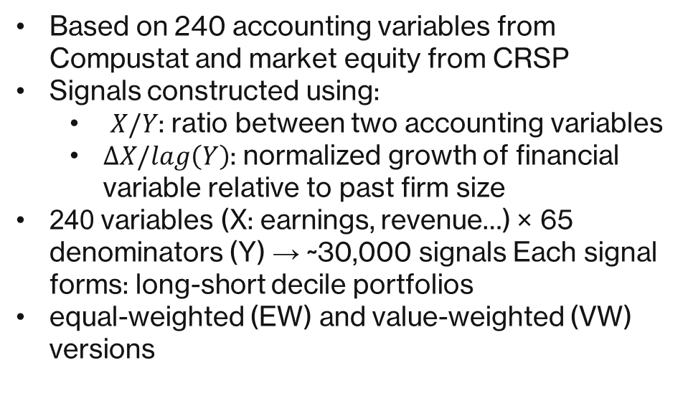
Accounting ratios (60,000 strategies)
Based on 240 accounting variables from Compustat and market equity from CRSP
Signals constructed using:
  $X/Y$: ratio between two accounting variables
  $ΔX/lag\left(Y\right)$: normalized growth of financial variable relative to past firm size
240 variables (X: earnings, revenue…) × 65 denominators (Y) → ~30,000 signals Each signal forms: long-short decile portfolios
equal-weighted (EW) and value-weighted (VW) versions
DataMinedLongShortReturnsEW
DataMinedLongShortReturnsVW

Slide 7

ticker information (38,000 strategies)
Stocks sorted by alphabetical order of ticker symbols
Split into 20 groups
Long 2 groups and short 2 groups
Repeated for 1st–4th ticker characters
Construct EW and VW long-short portfolios
TickerSignalsLongShort

Slide 8
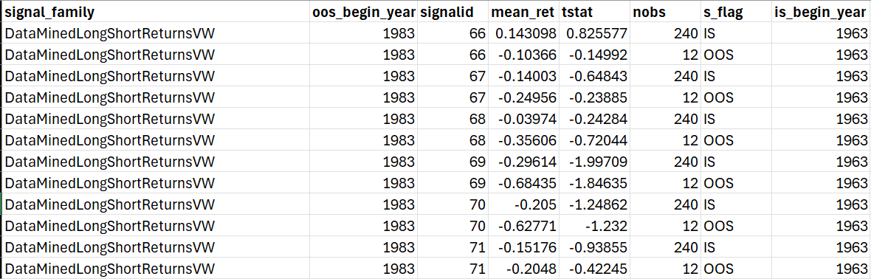
FINAL DATA

Slide 9
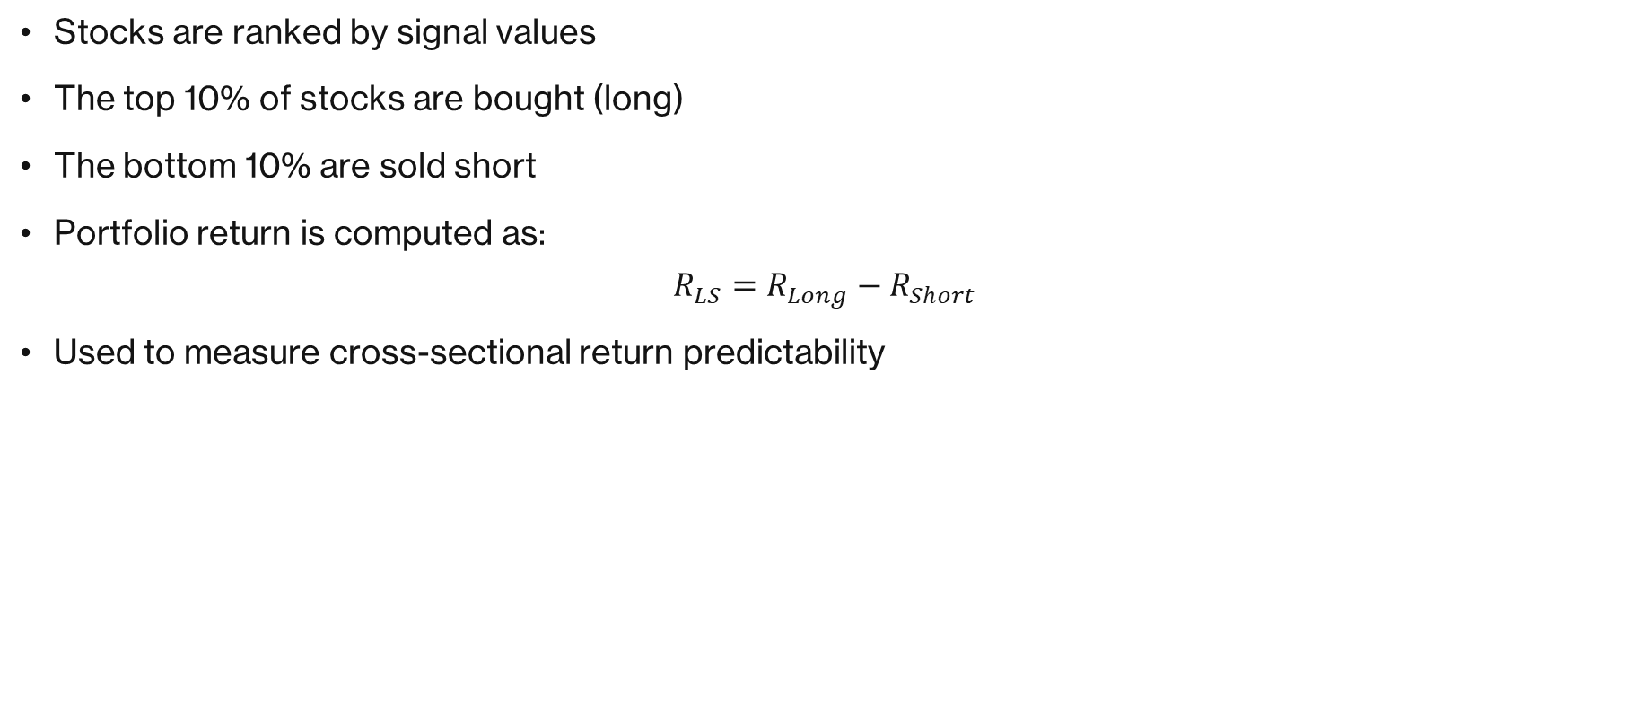
Long-short decile portfoliO
Stocks are ranked by signal values
The top 10% of stocks are bought (long)
The bottom 10% are sold short
Portfolio return is computed as:
$$R_{LS}=R_{Long}−R_{Short}$$
Used to measure cross-sectional return predictability

Slide 10
Methodology

Slide 11

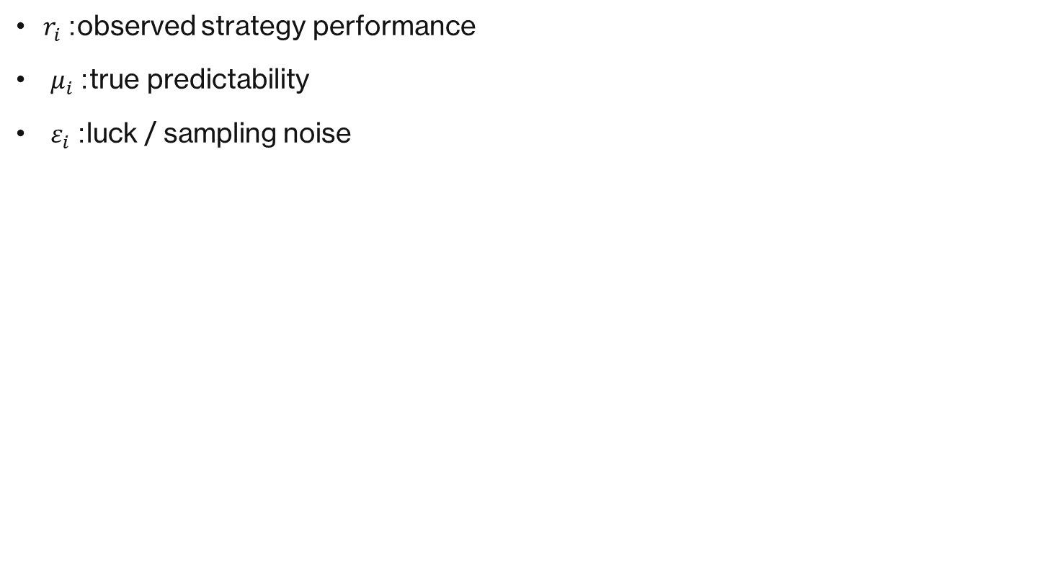
Empirical Bayes
$r_{i}$: observed strategy performance
$μ_{i}$: true predictability
$ε_{i}$: luck / sampling noise

Slide 12
Empirical Bayes
Data mining problem
  Selecting high-return strategies also selects lucky strategies
  Naive Sharpe ratios are upward biased
Empirical Bayes solution
  Estimate the expected noise component
  Shrink noisy strategies toward the mean
  Recover more realistic expected returns

Slide 13
Empirical Bayes
The paper uses the t-statistic of long-short returns as the performance measure
  t-stat = mean return / standard error
Each strategy’s latent performance is modeled using a mixture of two normal distributions Strategies are grouped into 6 families:
  accounting / past returns / ticker
  equal-weighted / value-weighted
Mixture models allow: skewness, fat tails, and heterogeneous predictability
Parameters are estimated using: quasi-maximum likelihood, based on the past 20 years of data
Empirical Bayes predictions are then used to estimate: expected returns, and Sharpe ratios

Slide 14
RESULTS

Slide 15
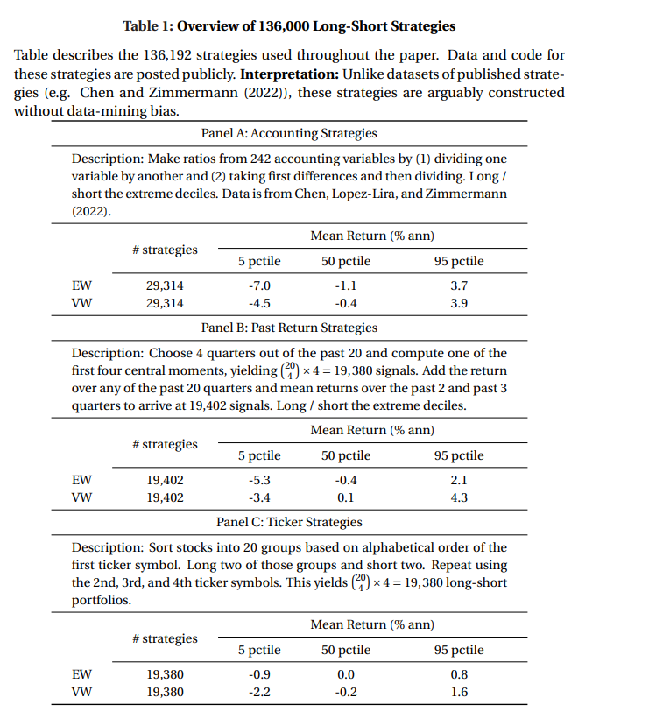
Paper’s results

